Slide 1
CUTESS DOGS
IN OUR WORLD

Slide 2
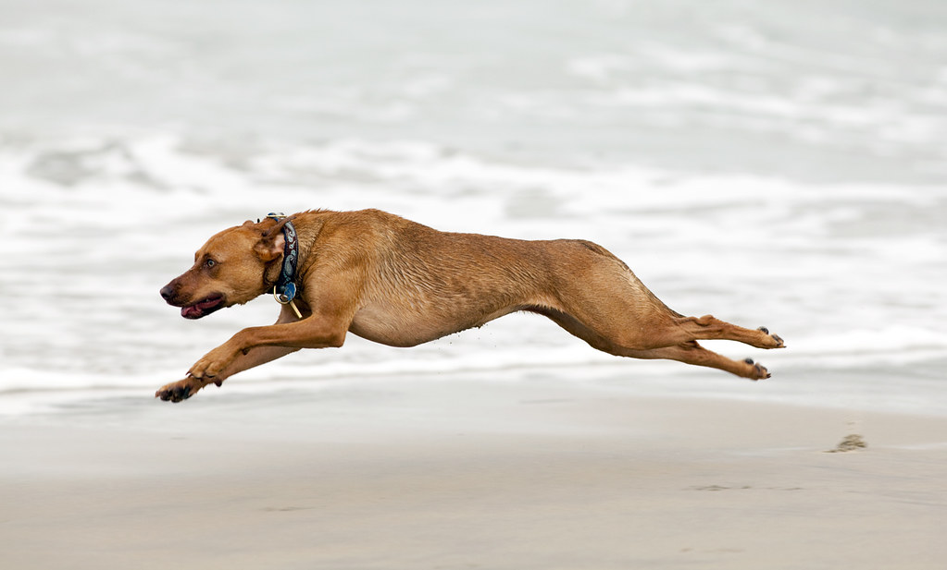
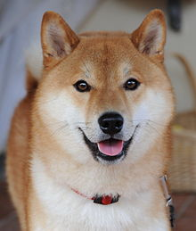
PRESENTATION CREATED BY : USAMA SHAKEEL
The quick brown fox jumps over the lazy dog. The quick brown fox jumps over the lazy dog. The quick brown fox jumps over the lazy dog. The quick brown fox jumps over the lazy dog. The quick brown fox jumps over the lazy dog.
The quick brown fox jumps over the lazy dog. The quick brown fox jumps over the lazy dog. The quick brown fox jumps over the lazy dog. The quick brown fox jumps over the lazy dog. The quick brown fox jumps over the lazy dog.
The quick brown fox jumps over the lazy dog. The quick brown fox jumps over the lazy dog. The quick brown fox jumps over the lazy dog. The quick brown fox jumps over the lazy dog. The quick brown fox jumps over the lazy dog.
This Photo by Unknown Author is licensed under CC BY-SA
This Photo by Unknown Author is licensed under CC BY-SA-NC

